Slide 1
Intramural Sports App
Gervonte Fowler
Marcenrold Cadet
Karun Mackoon
Peter Dranishnikov
Jordan Gilpin
Notes:
Presentation order/who’s doing what (Write in your names here):
Introduction: Jordan G.
Project Idea: Karun Mackoon
UI: Gervonte F
UI Flow: Mackernold Cadet
WireFrame Design: Peter Dranishnikov
--presentation notes below--(feel free to modify)
Introduction
Team introduction
Project focus
Design, the fact (details later)

Slide 2
Project Idea
Our intention is to create an app which provides users with up-to-date information regarding intramural sports including player stats, teams, upcoming games, leagues, etc. at Florida Poly
Core functionalities include:
Rec field presence and usage, using location services
Team data sharing between users, using web services
Local team data storage, using persistent data storage
Notes:
Project Idea (presenter notes, feel free to modify)
Overview
Information for Intramural sports at Florida Poly
Core features
Activity on the recreational area using location services
Sync & share team data between users using web services (REST-like API)
Store team data locally, offline use
For this project it is especially imperative that we create an application that not only has a quality user interface but is also fairly easy to navigate.

Slide 3
User Interface
Our main goal for the UI of our app is to make sure that it is quick, reliable, and easy to use providing florida poly students with all of their intramural sports needs
After going through other similar apps a common complaint was that the UI was buggy, slow, unoptimized, and ad ridden.
Our UI will not have these issues as we want to provide the students of Florida Polytechnic University with an efficient and organized design.
Since our app is focused on Florida Poly it will allow us to implement more personalized features such as the recreation area activity heatmap.
Notes:
User interface goals (presenter notes, feel free to modify)
No ads
Competitors have intrusive ads
Focus on delivering to Florida Poly students
Location services example
Activity of app users on rec fields

Slide 4
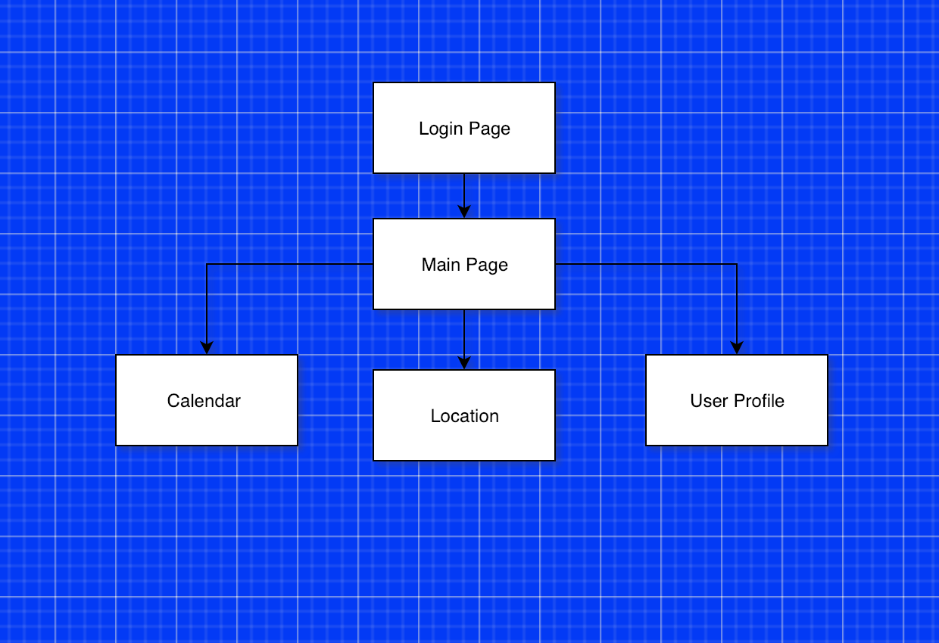
UI Flow

Slide 5
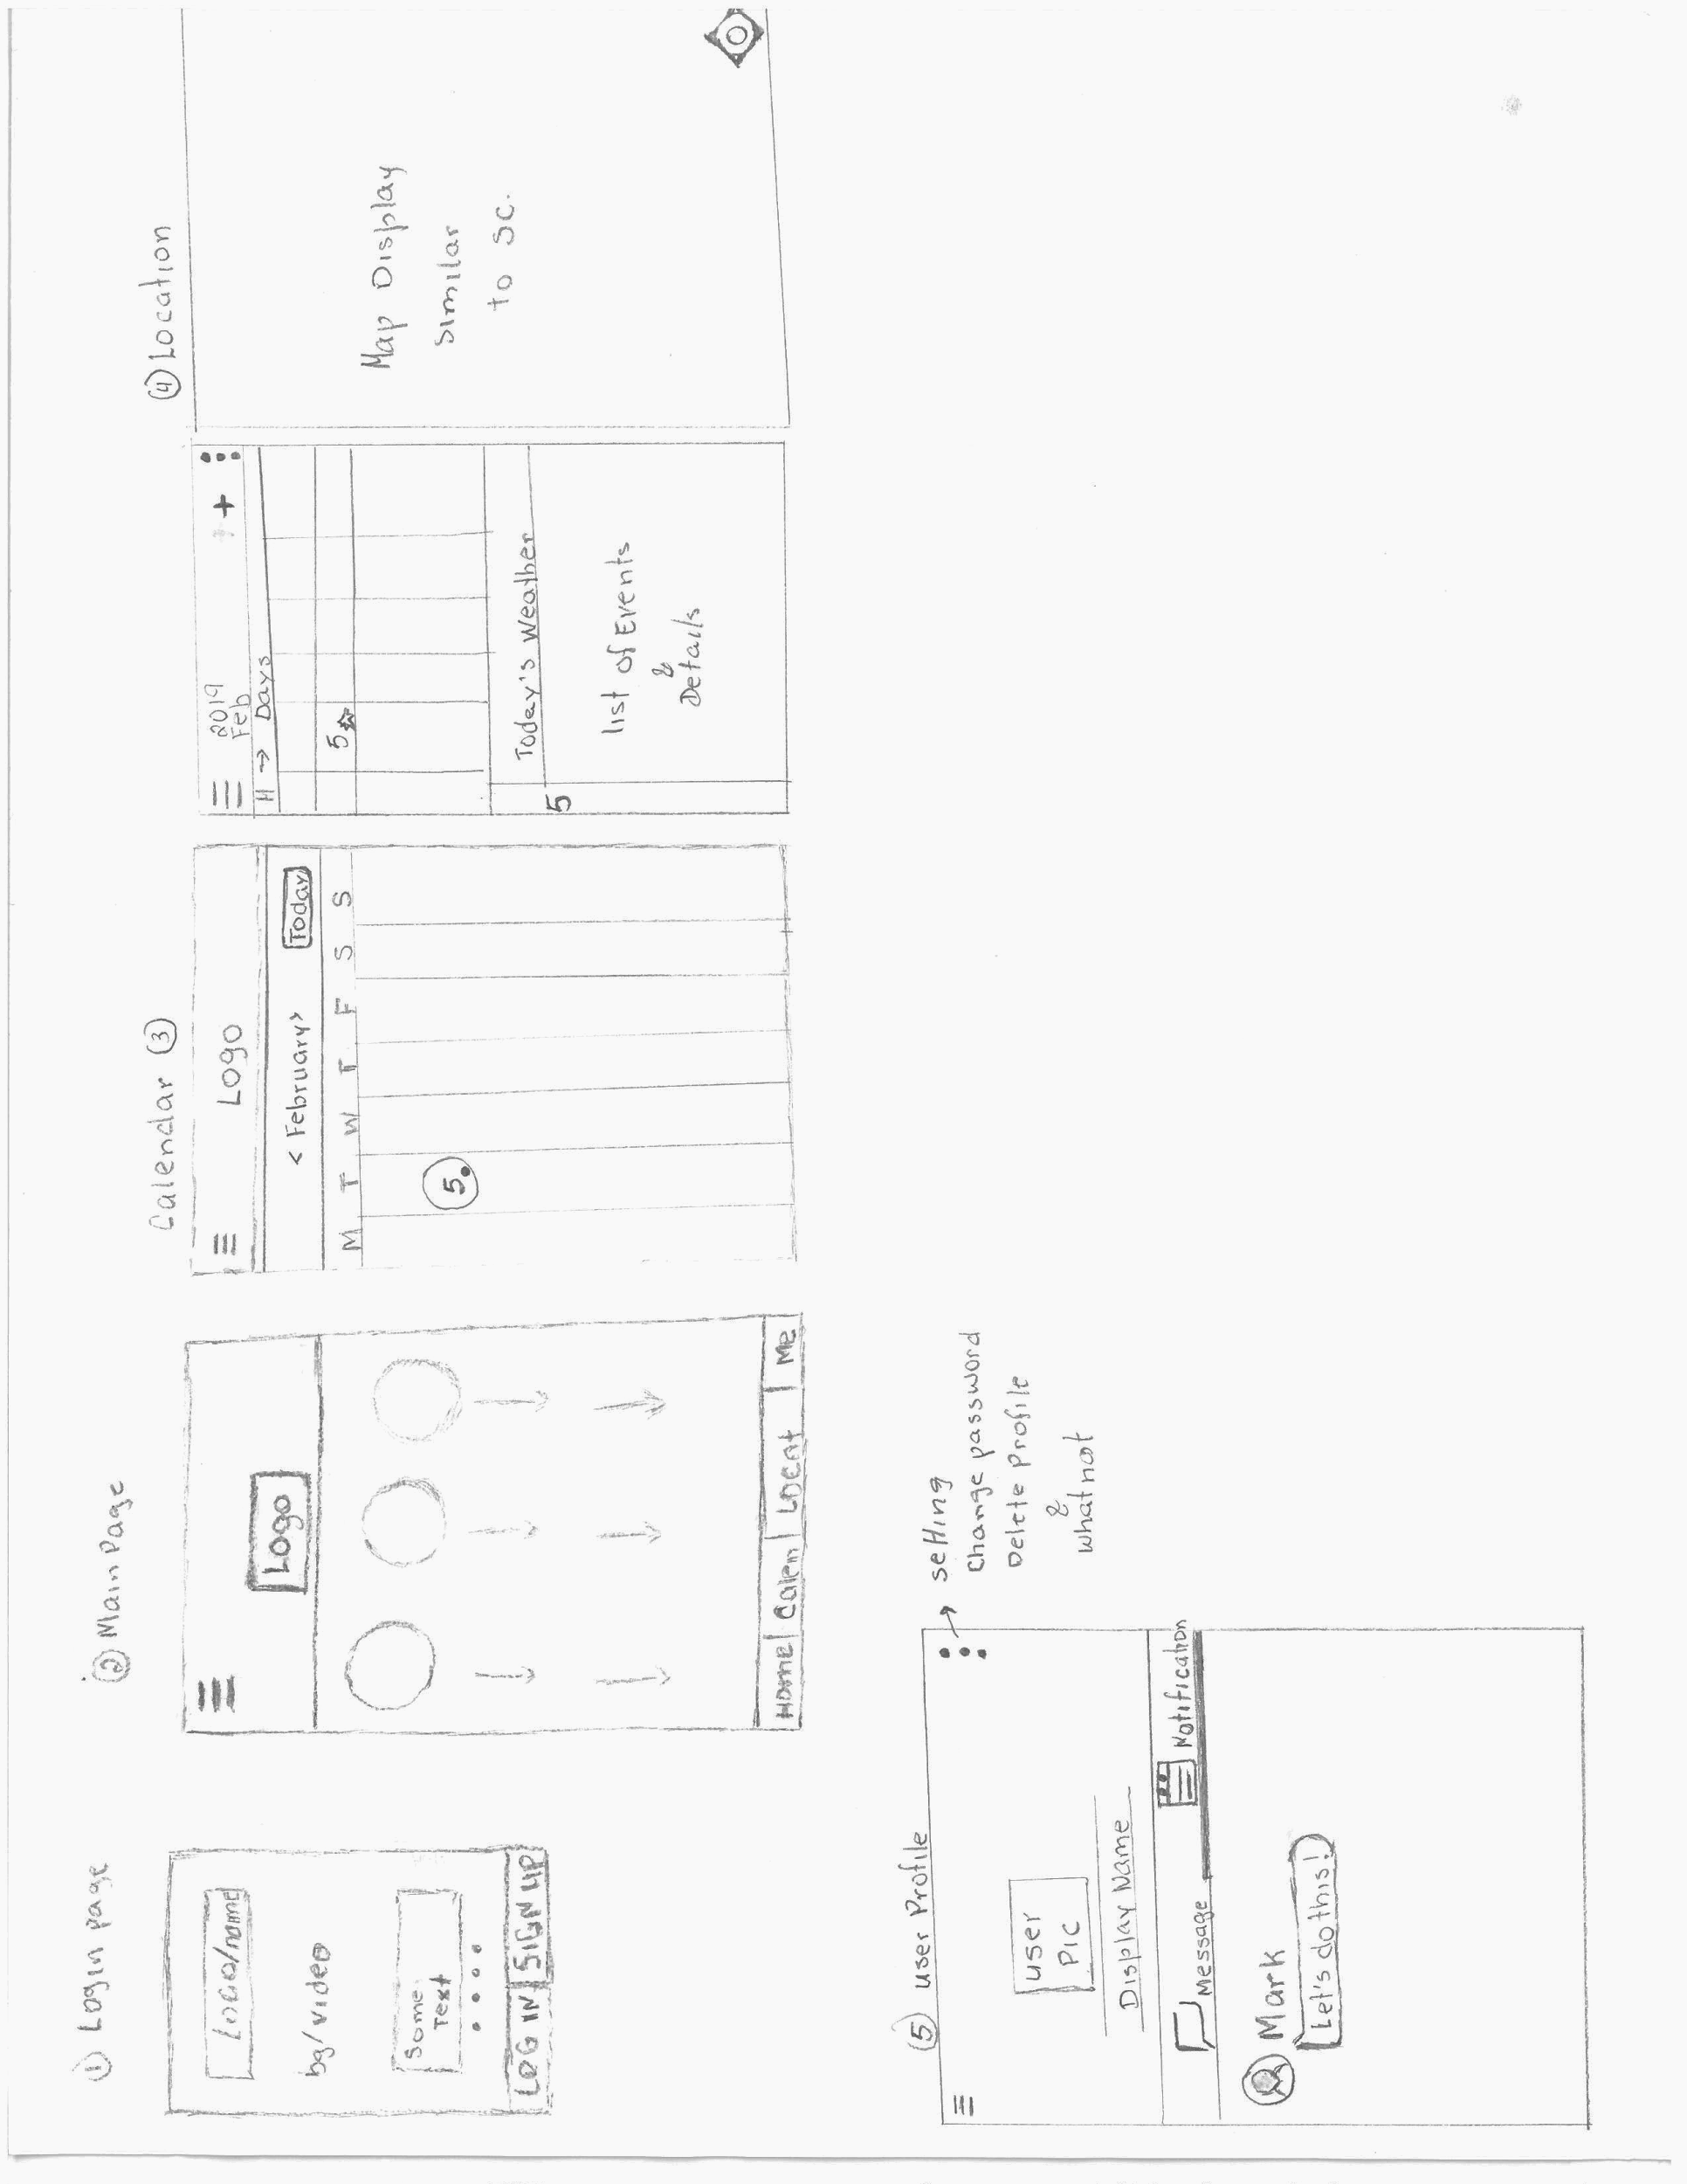
Wireframe Design
Notes:
Login/Signup page
Leads to main page
Skipped if login info saved
Main view
Shows all teams as expandable card matrix
Hamburger menu for navigating between different views
Calendar
Shows all sports events for the month
Basically a calendar
Sports Agenda
Shows upcoming sports events in week and agenda format
Add sports events here
Weather for the day (3rd party service)
Map view
Heatmap of the recreational area facilities
Team check-in
User Profile
Chat
App settings
Account settings

